Slide 1

Deepening aid impact through transparency and efficiency

Slide 2
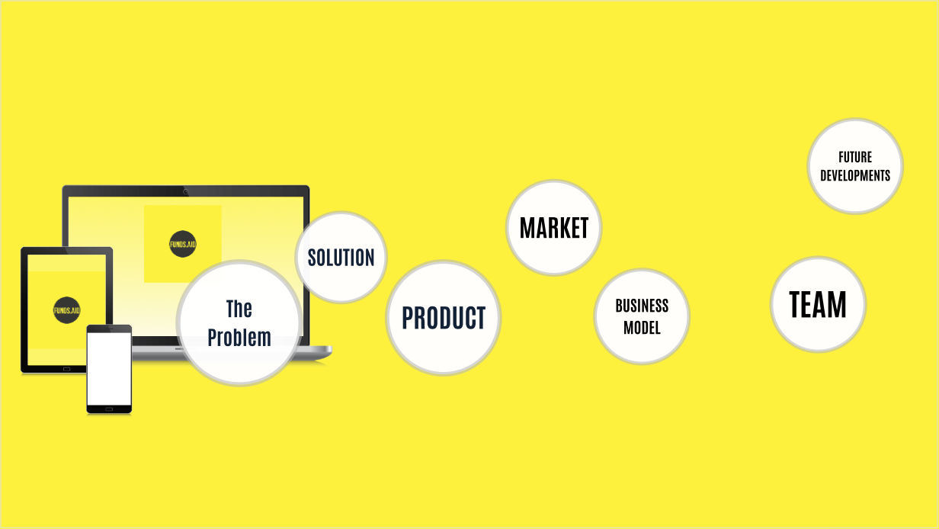

Slide 3
What problem are we solving?
30%
7.5%
Of donor funds do not reach the recipient due to corruption and fraud.
Of funds are lost to transaction fees.
Notes:
Funds are lost to corruption
Funding shortages in some instances leaves inadequate funding in other refugee camps.
The process is not transparent. It is difficult to measure the impact of donor funds.
Transaction costs are high. An average 7.5% of funds are lost to transaction
THE PROBLEM INEFFICIENCIES: Even in humanitarian foreign aid, (rather than political) the layers of bureaucracy involved are systematically removing most of the funds. The delivery ‘pipelines’ are beset by systemic inefficiencies at every stage, legacy banking issues, lack of transparency, misaligned accountability, and fundamental flaws in the thinking of the entire sector. Even processes to audit and define outcomes are counterproductive, adding more layers of manual administration, all of which can be manipulated to generate the desired ‘evidence’. These KPI demands also prevent smaller, probably more efficient and effective delivery partners from accessing the funds, because they lack the resources to jump through the required hoops. A system has evolved that is almost entirely self-serving, it’s primary objective being the administration of its own funding. It’s just the way it is. Reduced impact is one consequence. It’s impossible to say what percentage of funds are actually delivered to the intended ‘recipients’. In some instances, it will be 0%. The layers of corruption filter out everything.
CORRUPTION: Funding corrupt, kleptocratic systems and regimes, large or small, is more unethical and immoral than not sending the aid in the first place. It would be better to send zero aid, ever, than to send aid of which 90% is syphoned off. Some may argue that ‘even if it helps one person’ it’s worth it. This is dangerously flawed naïve thinking. Funding corrupt systems creates corrupt systems, which increase poverty, which in turn increases the case for aid. Funding corrupt systems creates an unvirtuous cycle, systematically rewarding the creation of more poverty. There is zero incentive for reducing poverty if poverty itself becomes a driver of aid. Funding corruption is utterly selfdefeating from an ‘aid’ perspective, it has the perverse outcome of making poverty into a revenue generating asset for corrupt officials.

Slide 4
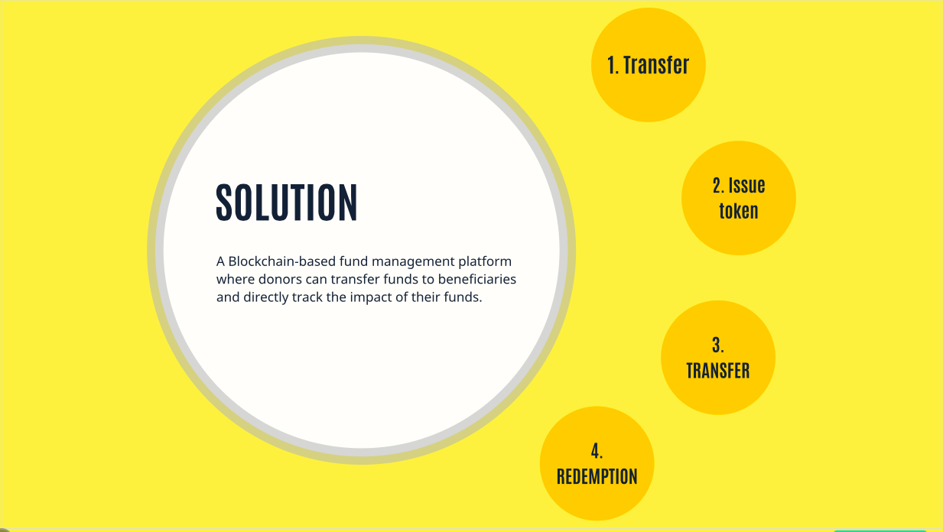

Slide 5
Solution
A Blockchain-based fund management platform where donors can transfer funds to beneficiaries and directly track the impact of their funds.
Project targets
Donor and Aid Agency agree on project objectives and budget.
Funds transfer
Donor transfers funds to be disbursed into Partner bank escrow account.
Tokens issued
Partner bank issues tokens on behalf on donor.
Token disbursement
Tokens are disbursed to beneficiary.
Token usage
Beneficiary uses tokens to purchase goods from Merchant.
Token redemption
Merchants convert tokens into cash via Partner Bank.
Notes:
Through our platform, we are able to offer

Slide 6
Product
Our product allows for seamless transfer of funds from the donor straight to the correct beneficiary.
Donor transfers money into Partner Bank’s Escrow account.
Partner bank logs onto Funds Aid portal and creates tokens that are backed by fiat currency
(1 token – 1 fiat currency)
Partner Bank distributes tokens to Beneficiaries' wallets.
Beneficiary uses tokens to purchase goods at merchants.
Merchant receives equivalent value of tokens in fiat currency.
Financial transaction flow
Creation of Blockchain digital identity
Local government registers beneficiaries onto the Blockchain.
Notes:
Assumptions
Donor transfers in bulk

Slide 7
The Market
145
Billion
25
Billion
10
Billion
Amount of foreign Aid disbursed by donors.
Average value of aid disbursed to Africa
Potential market share
Total Donor market
Addressable market
Target market share

Slide 8
Value Proposition
Our value proposition seeks to provide with a transparent, user friendly and affordable platform.
INCREASED TRANSPARENCY
LOWER TRANSACTION FEES
IMPACT ASSESMENT
FINANCIAL INCLUSION
Donor can easily track the disbursement of their funds.
Unused tokens are destroyed, thereby reducing fraud.
Lower transaction fees for transfers of donor funds.
Easier to track the impact of donor funds.
Prioritize allocation of donor funds.
Financial inclusion of vulnerable individuals.
Notes:
Funds Aid platform enables donors, governments and NGO’s to transfer, trace funds.
We help donors understand areas where they are making an impact.

Slide 9
Business Model
The platform makes money through transaction fees, user portal fees and charges on token conversion.
PLATFORM USAGE FEES
TRANSACTION FEES
TOKEN EXCHANGE CHARGES
Number of Donors x annual platform subscription fee.
% fee on transaction on executed through platform.
% fee on transaction on executed through platform.
Notes:
Main challenges
Can you explain the Registration process
- Electricity
Connectivity
Store of value/ transactions
Impact reports
Usage of distribution (registration of merchants to track the info - breakdown to compents)
Sub-wallet, control what they buy – incentives
ussd

Slide 10
Customer acquisition strategy
DIRECT BUSINESS ENGAGEMENT (COLD CALLING)
PARTNERSHIPS WITH FINANCIAL INSTITUTIONS
STRATEGIC WORKSHOPS AT DONOR CONFERENCES
CONTENT CREATION
Conduct an initial pilot and target in country donors
Target global donors (WFP, OXFAM) with working proof of concept.
Foster relationship with reputable international partner banks that are preferred bankers of donors (Stanchart, Barclays)
Exhibit product at local and global conferences such as UN aid conference.
Create a workshop and invite donors participate in awareness.
Create marketing content, e.g. explainer video, infographics and distribute through social media.
Advertise on platforms such as Devnet.

Slide 11
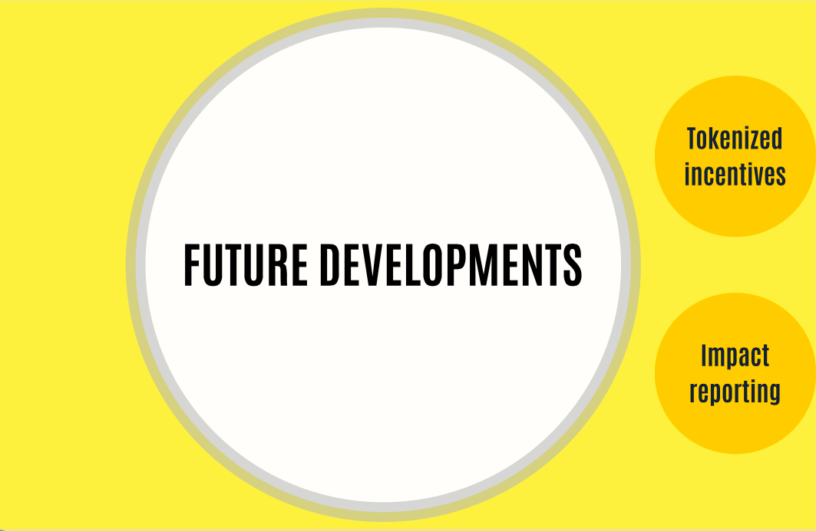
Future Developments
Tokenized incentives to reward NGO’s for achieving results.

Slide 12
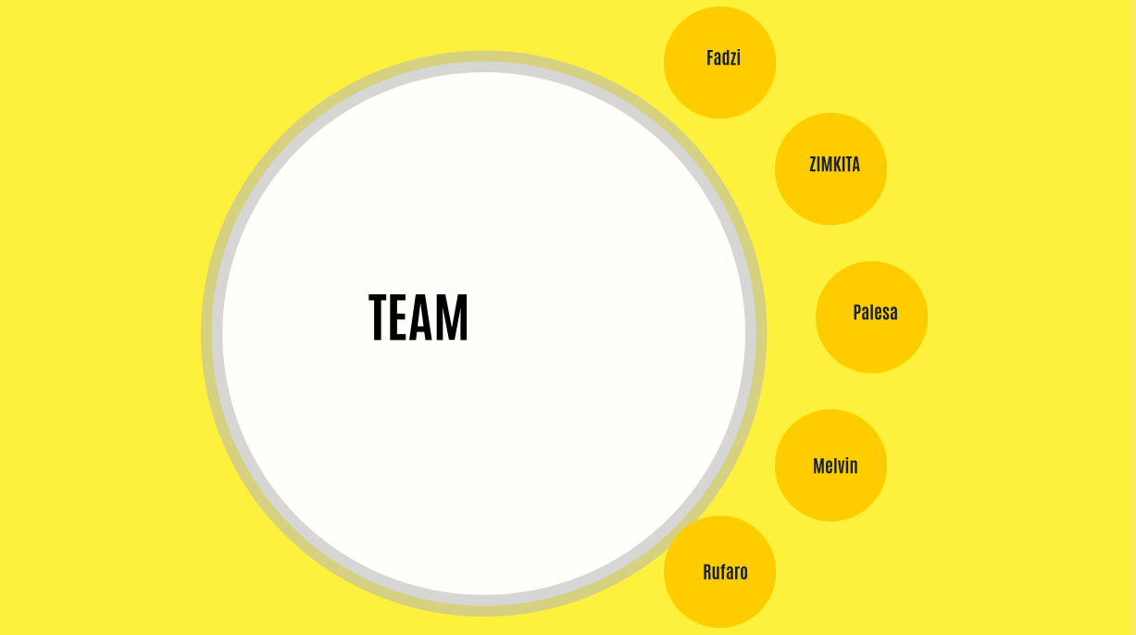
Our Team

Slide 13
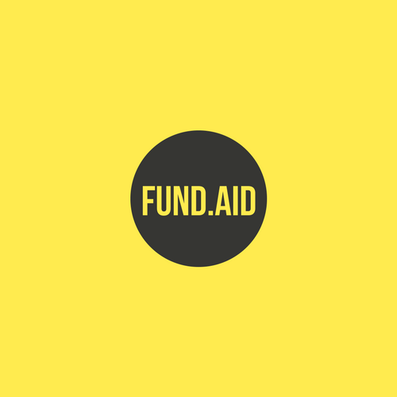

Slide 14
Target Infrastructure model
Blockchain Network
Merchant Ecosystem
Participating Bank Application
(Bank web portal)
Donor tokenization (smart contract)
Token disbursement
Merchant POS app
Record beneficiary transactions
Token redemption for fiat
(Web app- HTML, CSS)
Beneficiary User Verification
Donor app
Reporting
User registration (local donor partner)
(Donor web portal)
User generation (beneficiaries)
Token redemption

